Slide 1
Welcome to Marketing Management
Dr. Cecilia Ruvalcaba
BUSI 107 Week 13

Slide 2
ADVERTISING, PUBLIC RELATIONS, AND SALES PROMOTIONS

Slide 3
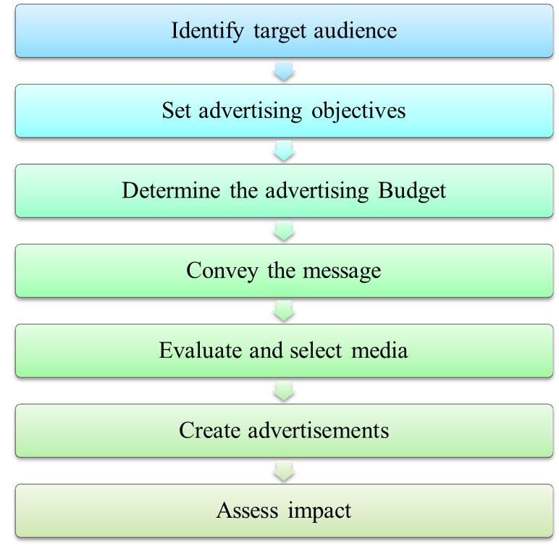

Slide 4
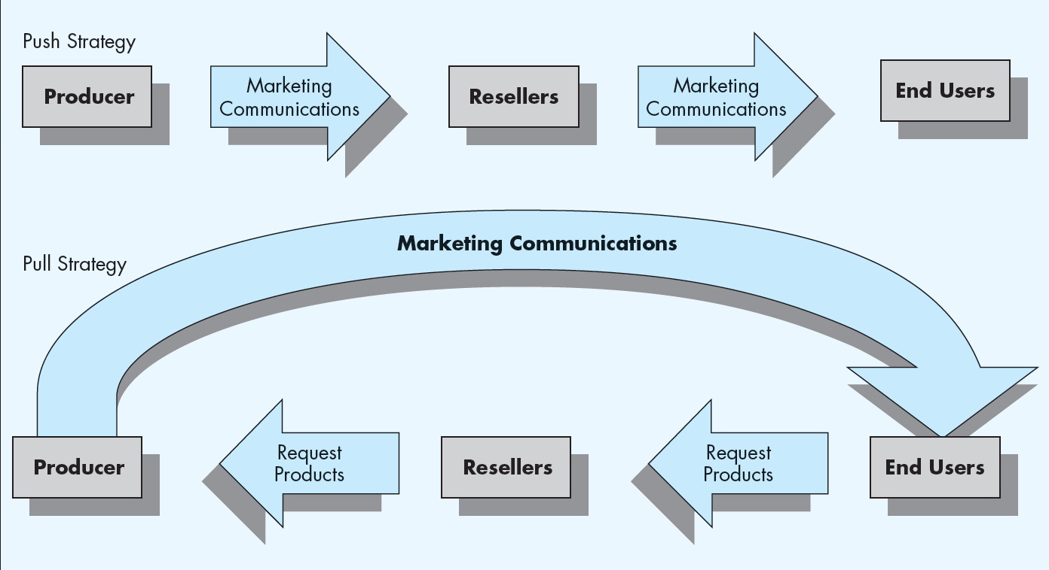
Advertising objectives

Slide 5
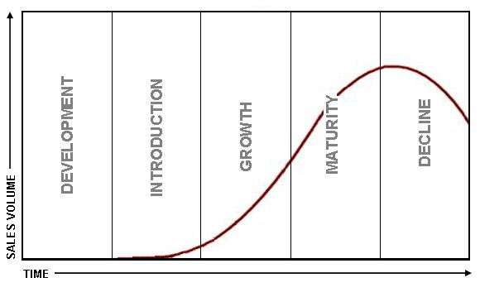
Advertising Objectives cont…
Inform - to tell about a product; early in the life cycle
Persuade - growth stage; “buy my brand, not my competitor’s;” used often by nonprofits
Remind - keep name in public eye; maturity stage; to trigger the consumer’s memory

Slide 6

Informative advertising
Create and build brand awareness
Push the consumer through the buying cycle
Inform customers about upcoming sales events or arrival of new merchandise

Slide 7


Persuasive advertising
Generally occurs in the growth and early maturity stages of the PLC when competition is most intense
May be used to reposition an established brand in the later stage of the PLC

Slide 8

Reminder advertising
Communication used to remind or prompt repurchases
Occurs after the products have gained market acceptance

Slide 9


Ad Focus
Institutional Product

Slide 10
Advertising Strategies
Awareness
Comprehension
Conviction
Action
Inform - to tell about a product; early in the life cycle
Persuade - growth stage; “buy my brand, not my competitor’s;” used often by nonprofits
Remind - keep name in public eye; maturity stage; to trigger the consumer’s memory
V
Target Market: Who are you trying to reach?
Demographic, Psychographic, etc…
Product Strategy: What VALUE does the customer get?
Benefits/Features, functional value, social value, emotional value, experiential value
Message Strategy: What is the strategy (inform, persuade, remind), build image?
What are you saying and how? Signs, symbols, verbal and non-verbal cues
Execution: What message channel will you use? Avg. Frequency vs. Reach

Slide 11

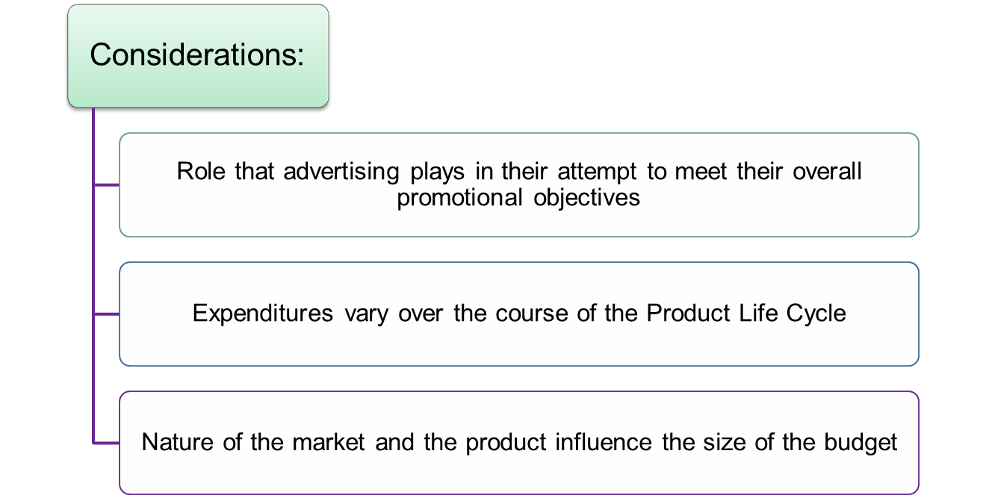
Advertising Budget
Budget Size
Percent of Sales
Per-Unit Expenditure
All You Can Afford
Competitive Parity
Research & Task Approach
Allocation- Say the right thing in the right place at the right time

Slide 12

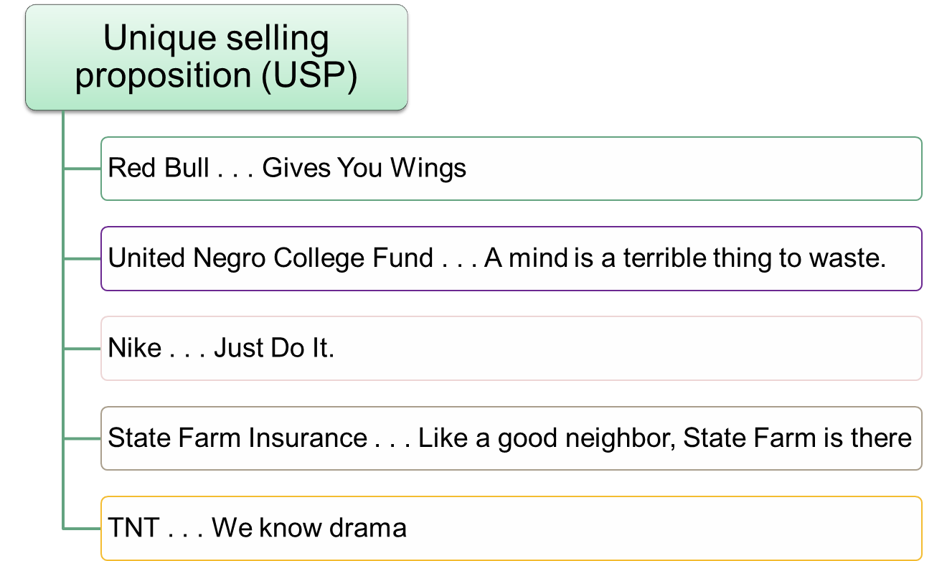
Convey The Message

Slide 13


Advertising Appeal
Rational/Informational approach
Depend on logic and speak to the consumer’s intellect; based on the consumer’s need for information
Emotional approach
Tugs at the heartstrings or uses humor

Slide 14

Creative Execution
Creative execution
The way an appeal or proposition is presented
straight sell
scientific evidence
demonstration
comparison
slice of life
animation
fantasy
dramatization

Slide 15

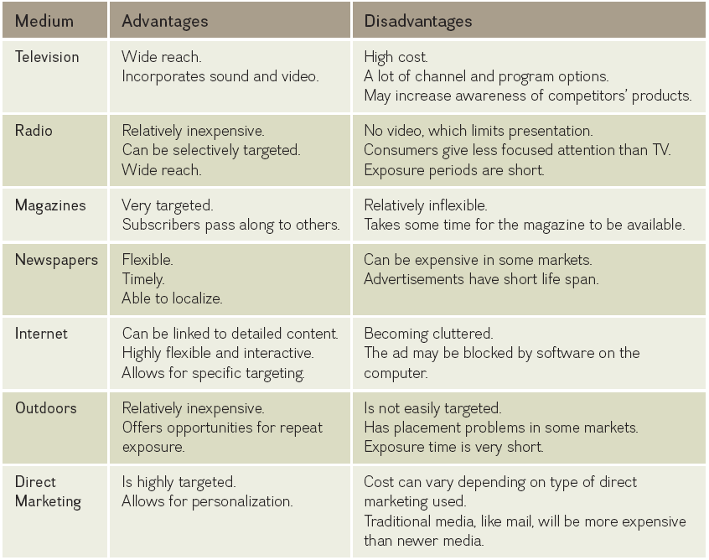

Media Selection
Mass media reach large anonymous audience
Niche media reach a smaller more targeted audience

Slide 16
Ad Creation
Ads
The type of medium determines the execution style
Creativity plays a major role in the execution stage
Creativity should not overshadow the message
The execution style must match the medium and objectives

Slide 17


Take Away for Today
Advertising
Knowing your objectives provides for a successful communication.
Know your PLC!
Where are your customers and competitors?
Sending the right message
Fit your message to your brand persona
Social Responsibility
Beyond product and performance… to PERSON

